Slide 1

AIoT Bedroom Environment
Sha Tin Methodist College - Au Ka Long

Slide 2




Real life problem
Can’t get a comfortable sleep and comfortable relaxing place.
Example
Get on bed and ready to sleep but lights is still on ,this would be hard and tiring for you to get up again.
Weather change fast and you are cold or hot, needing air-conditioner or heater to be on.

Slide 3


My idea
Let a machine with sensor detecting your need and automatically help you to give a comfortable environment.
Examples
Auto turn on lights when you are ready to sleep
Auto turn on air-conditioner/hearer and auto change the temperature for your best comfort.

Slide 4





How does it work
Three main parts
Input(sensors)
AI
IOT

Slide 5




How does it work --- Input
IR camera
Get the image(high privacy)
The temperature of the environment
-> Support the object detection
-> Constraints for automation

Slide 6
The Advantages of IR camera
High privacy
Cannot capture the face
Much better than HD camera
More useful constraints
Temperature
More accurate body gesture
Can detect the body gesture even the person is covering a blanket

Slide 7




How does it work --- AI
Object detection
Detect the position of person
Detect the gesture of person

Slide 8

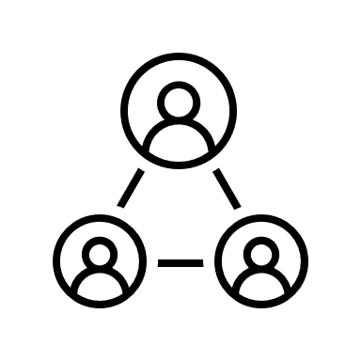


How does it work --- IoT
Two kind of triggering different devices
Events triggering
Different kind of body gesture
Temperature change
Habit trigger
Turn on air-conditioner before sleep time

Slide 9
How does it work --- Extensibility
Two ways to extend
Add new IoT devices
Auto detect new devices(network / camera->Events)
Include to the environment
Add other non-IoT objects
Auto detect new object(camera->Events)
Remind you to use it, etc.

Slide 10
How does it earn?
Selling the IR camera
Selling other smart home product to integrate with environment
High extensibility make this possible

Slide 11
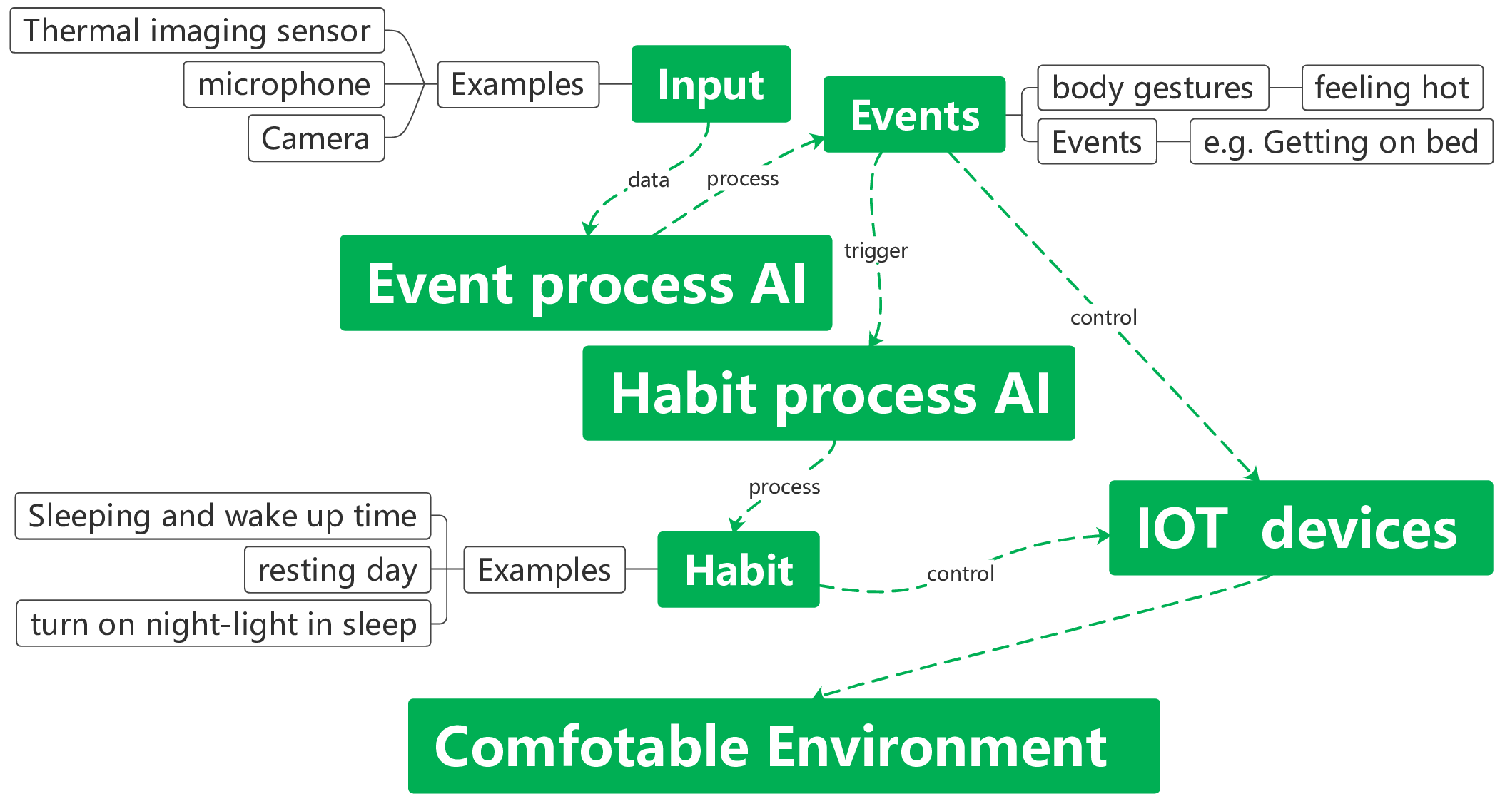
How does it work --- Workflow

Slide 12
THE END

